Slide 1
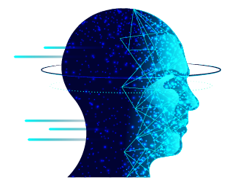
Sign Language Detection
Real Time Aid Using TensorFlow and OpenCV

Slide 2
Prepared By:
Name: Patel Heel
Roll No : 132
Enrollment No : 22002171410039
Batch : A4
Branch : CS&IT
Name: Samay Bhavsar
Roll No : 113
Enrollment No : 22002170110014
Batch : A4
Branch : C.E.
Name: Shaleen Kureshi
Roll No : 109
Enrollment No : 22002170110061
Batch : A4
Branch : C.E.
Name: Saini Harsh
Roll No : 122
Enrollment No : 22002171410049
Batch : A4
Branch : CS&IT
Name: Vora Manan
Roll No : 120
Enrollment No : 22002171410066
Batch : A4
Branch : CS&IT

Slide 3
Outline:
01
04
02
05
03
06
Introduction
Merits
Sign language
Demerits
Workflow
Future Scope

Slide 4
Introduction
Brief Overview of the project:
This project aims to develop a real-time sign language recognition system to aid communication for deaf individuals.
Importance of sign language recognition:
Sign language is the primary mode of communication for deaf individuals, and accurate recognition of sign language gestures is crucial for effective communication..

Slide 5
Sign Language and Gestures
Explanation of sign language:
Sign language is a visual language that uses hand gestures, facial expressions, and body movements to convey meaning.
Role of technology:
Technology plays a significant role in facilitating communication for deaf individuals by providing tools and solutions for sign language recognition and interpretation.

Slide 6
Workflow
Capture frames from the camera: Frames are captured from a camera in real-time.
Preprocess frames: Preprocessing techniques are applied to the frames to enhance the quality and prepare them for analysis.
Perform sign language recognition: A TensorFlow model is used to recognize and interpret sign language gestures in the preprocessed frames.
Visualize recognition results: The recognized sign language gestures are visualized on the frames using OpenCV, enabling real-time feedback.

Slide 7
Merits:
Accessibility: It enhances accessibility for the deaf and hard of hearing community.
Efficiency: Sign language detectors can facilitate more efficient communication by providing instant translation.
Research: They can be used in linguistic research and analysis of sign language patterns, contributing to a better understanding of sign language structure and usage.

Slide 8
Demerits:
Accuracy:Errors in translation can lead to misunderstandings or miscommunication.
Limited Vocabulary: Existing sign language detectors may have a limited vocabulary.
Privacy Concerns: Sign language detectors may raise privacy concerns related to the collection and storage of sensitive personal data

Slide 9
Future Scope:
Enhanced Gesture Recognition
Dynamic Gesture Recognition
Real-time Feedback and Correction
Integration with Assistive Technologies

Slide 10
Thank You!

